Slide 1
Analysis of Spotify trends using tableau
By
Nivinraj K
Batch - MB25

Slide 2
Spotify
Spotify is a digital music, podcast, and video streaming service that gives users access to millions of songs and other content from artists all over the world.
Overview
Founded: April 23, 2006
Launched: October 7, 2008
Founders: Daniel Ek and Martin Lorentzon
Headquarters: Stockholm, Sweden
Business Model
Freemium Model:
Free access with ads.
Premium subscription for ad-free experience and additional features.
Revenue Streams:
Subscription fees from premium users.
Advertising revenue from free tier.

Slide 3
Market Presence
Global Reach:
Available in 184 markets worldwide.
User Base:
Over 356 million active users.
More than 158 million premium subscribers.
Future Outlook
Innovations:
Continuous investment in AI and machine learning for better personalization.
Expansion:
Exploring new markets and partnerships.
Content Development:
Increasing investment in exclusive content, particularly podcasts.

Slide 4
Spotify trend analysis
Welcome to our presentation on Spotify trend analysis, where we dive deep into the patterns and preferences of music listeners worldwide. As music streaming continues to grow exponentially, understanding these trends is crucial for artists, producers, marketers, and anyone involved in the music industry.
This analysis includes of * Most popular tracks and artists.
*Popularity by country.
* Streaming over time.
And some Key Performance indicators based on this analysis to create advertisement in spotify to be a competitive in music industry.

Slide 5
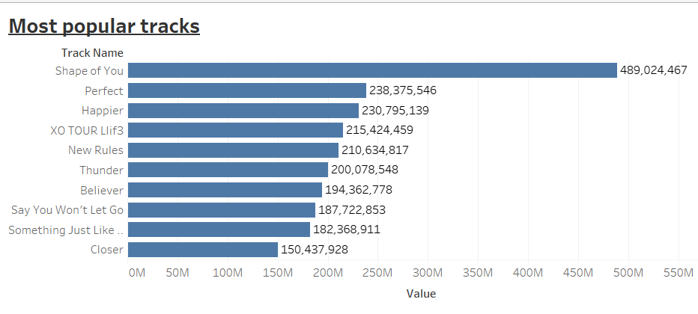
Top 10 popular tracks:

Slide 6
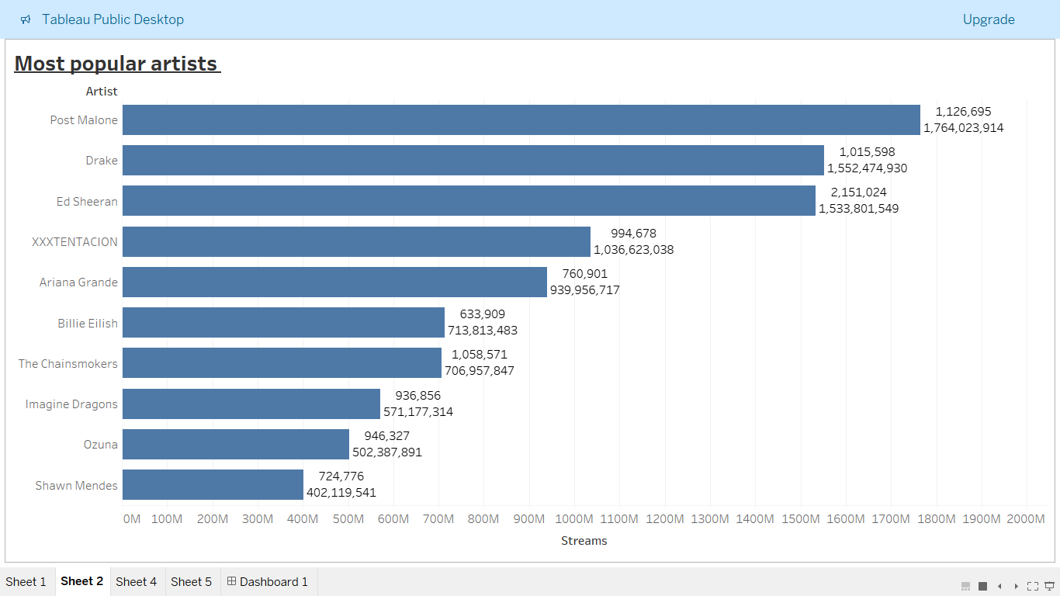
Top 10 popular artists:

Slide 7
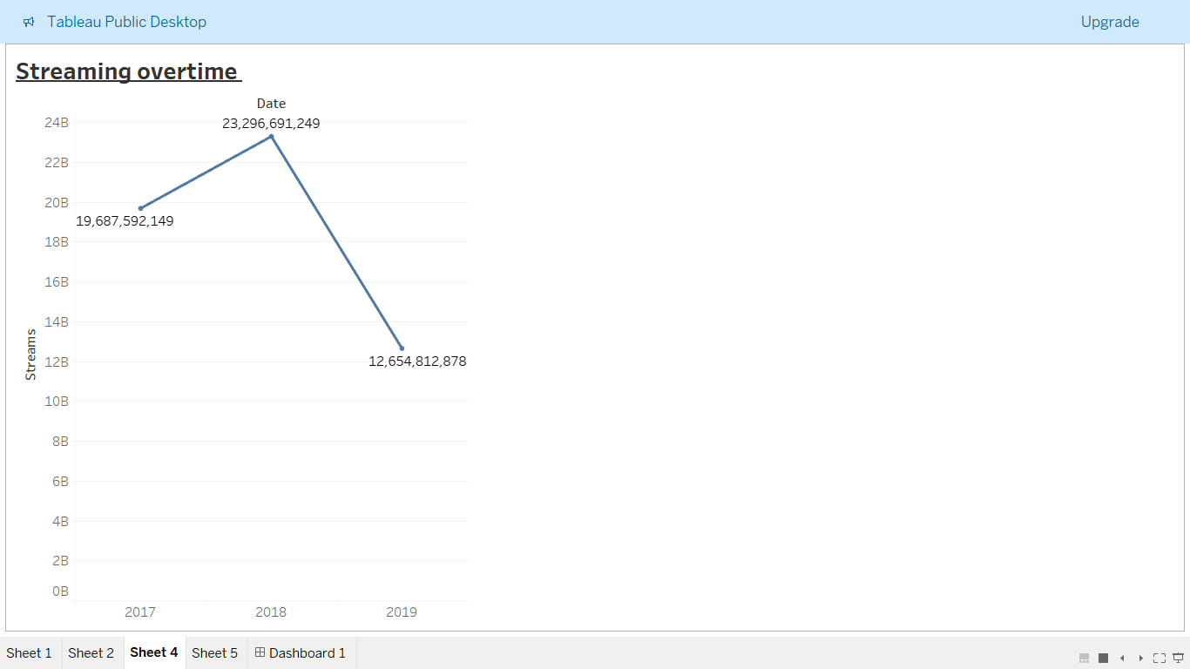
On analyzing the given data it is found that Year 2018 has the highest streaming time comparative to the year 2017 and 2019.

Slide 8
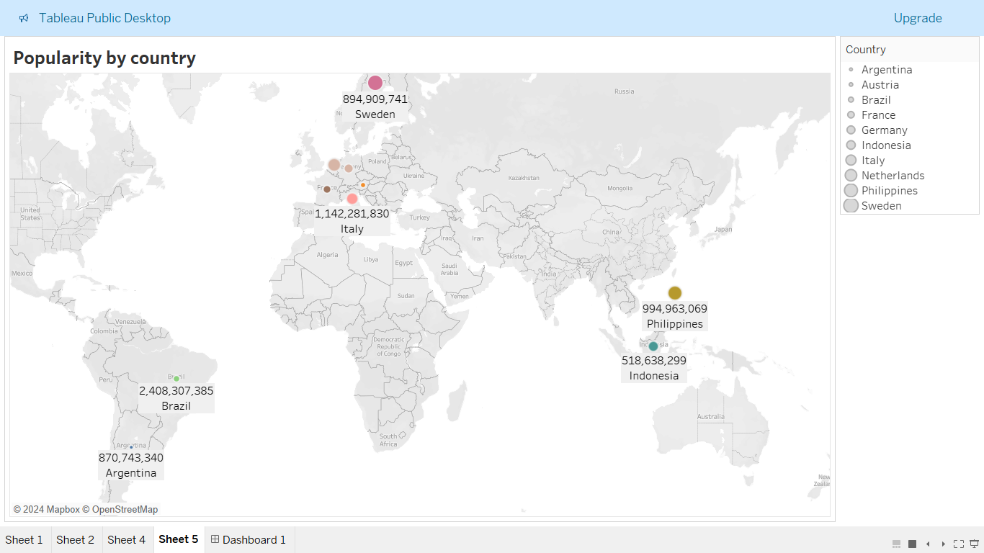
Top 10 countries based on streaming:
This charts tells that highest streaming is done Sweden, followed by Philippines and Netherland.
The least streaming area is Argentina.

Slide 9
KPI based on analysis:
This KPI’s based on analysis of trends of Spotify in worldwide area are as follows:
User Engagement: On analyzing the data, it is clear that during the year 2018 the user’s have engaged high on comparing to the year 2017 & 2019.
Content Consumption: On analyzing the tracks, “Shape of you” is the most played track, followed by the tracks called “prefect” and “happier”.
On analyzing the data’s of artist, An Artist called “post Malone” is the top streamed artist among all.
Demographic : On ranking top 10 countries from the give data, It is clear that people of Sweden uses the most and Argentina stands least in using spotify.

Slide 10
Final thoughts:
Spotify's trend analysis underscores the platform's strong position in the music streaming industry, driven by its user-centric approach, innovative features, and continuous focus on personalization. By capitalizing on the identified trends and opportunities, Spotify can further strengthen its market leadership, attract new users, and provide an unparalleled music and audio experience to its global audience.
Thank you

